Slide 1
Virtualization
By
Tabinda Ali Shah Zaman

Slide 2



Virtualization is defined as the abstraction of objects ("things”), creating a virtual (rather than actual) version of objects such as a server or storage device.
For example, when you partition a hard drive into two partitions - C and D, say - you create virtual drives but the physical hard drive has not changed.
Virtualization is a technology to run multiple same or different operating systems which is completely isolated from each other . ”Ex: Run both Windows and Linux on the same machine.

Slide 3

:-In computing, virtualization or is the act of creating a virtual version of something at the same abstraction level, including virtual computer hardware platforms, storage devices, and computer network resources.

Slide 4


c«t :- A virtual machine (VM) is a software implementation of a machine that executes programs like a physical machine. It shares physical hardware resources with the other users but isolates the OS or application to avoid changing the end-user experience.
«a Virtual Machine is the part of cloud computing.

Slide 5
Where are your Machine?
Who has access łhese system?
How are they managed?
What security is place.

Slide 6





















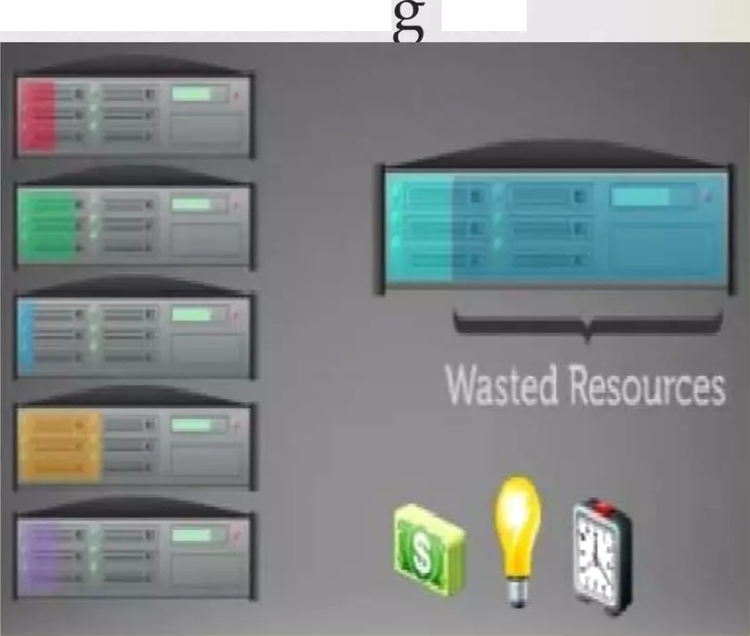

VM share the centralized server processor, memory
storage.
Earlier 800 Million unique server is working.
But with VM only 60 Million server is doin the
same work 800 Million server.

Slide 7











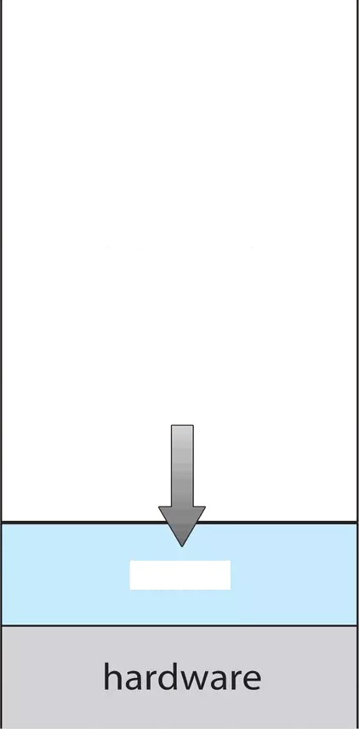
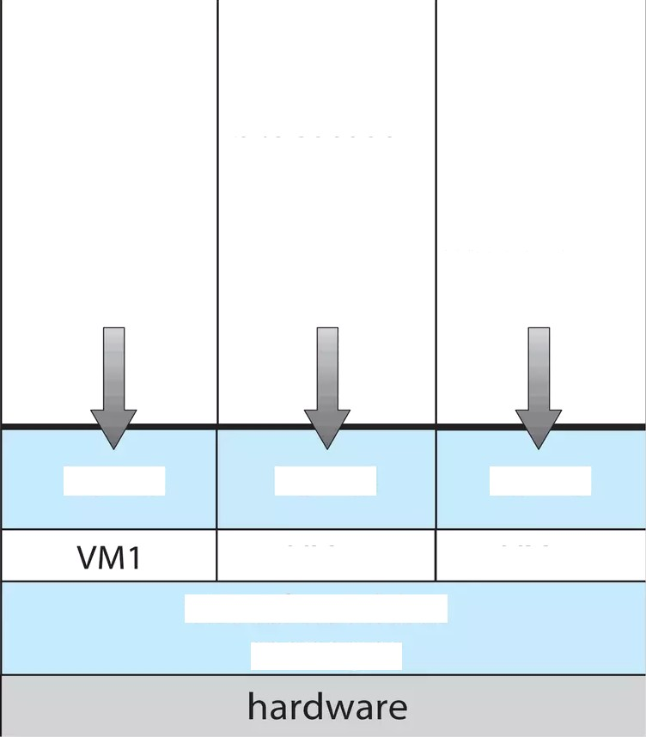






processes
processes
processes
processes
rammi interface
kernel
kernel
kernel
V 3
VM2
virtual machine
manager
kernel
irtu I chi

Slide 8


application | application application appl guest operating guest operating guest system system sy (free BSD) (Windows NT) (Windo virtual CPU virtual CPU virtual virtual memory virtual memory virtual virtual devices virtual devices virtual virtualization layer | ication operating stem ws XP) CPU memory devices
host operating system (Linux)
c u | hardware ego I O de ces

Slide 9




















Operating Sçstem:
The operating system actually
hardware
ing the
simulates
Together with
environment
Gues Operatíng Sçstem:
The operating system running
environment
HOH
the simulated
.g., the one we are trying debug

Slide 10
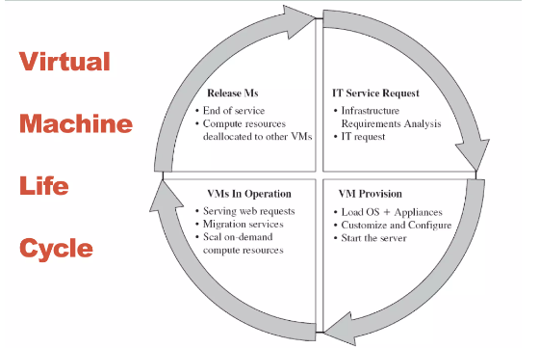
Life Cycle Of Virtual Machine

Slide 11



ca A hypervisor or virlal machine monitor VMM is a piece of computer software, firmware or hardware lhat creates and runs virtual machines.
ca A computer on which a hypervisor is running one or
more virtual machines is defined as a hos/ aaeh?ae.
Each virtual machine is called a guesf inarhiae
‹in Hypervisor is a bare metal approach; is installed on the bare metal and then the operating systems is installed ( para virtualized)

Slide 12








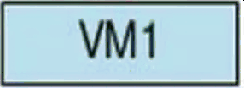
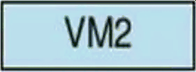
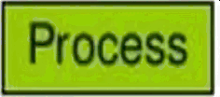
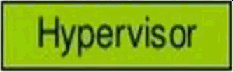

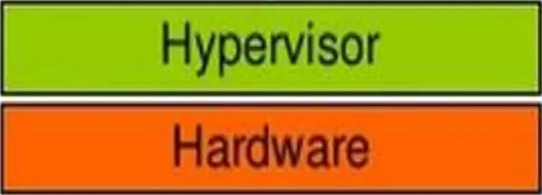
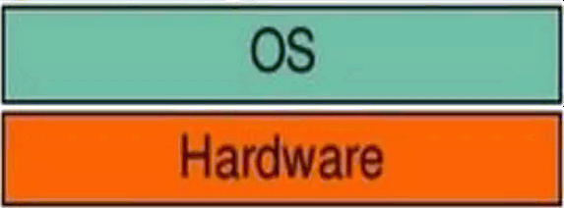

Bare-Meta (Type 1)
Hosted (Type 2)
Guest
Guesl
!3OS!

Slide 13




















sys (also known as full
System virlual machine:
virtualization VMs provide complete substitute
lhe targeted real machine and level functionality required lhe execulion complete operating syslem.

Slide 14
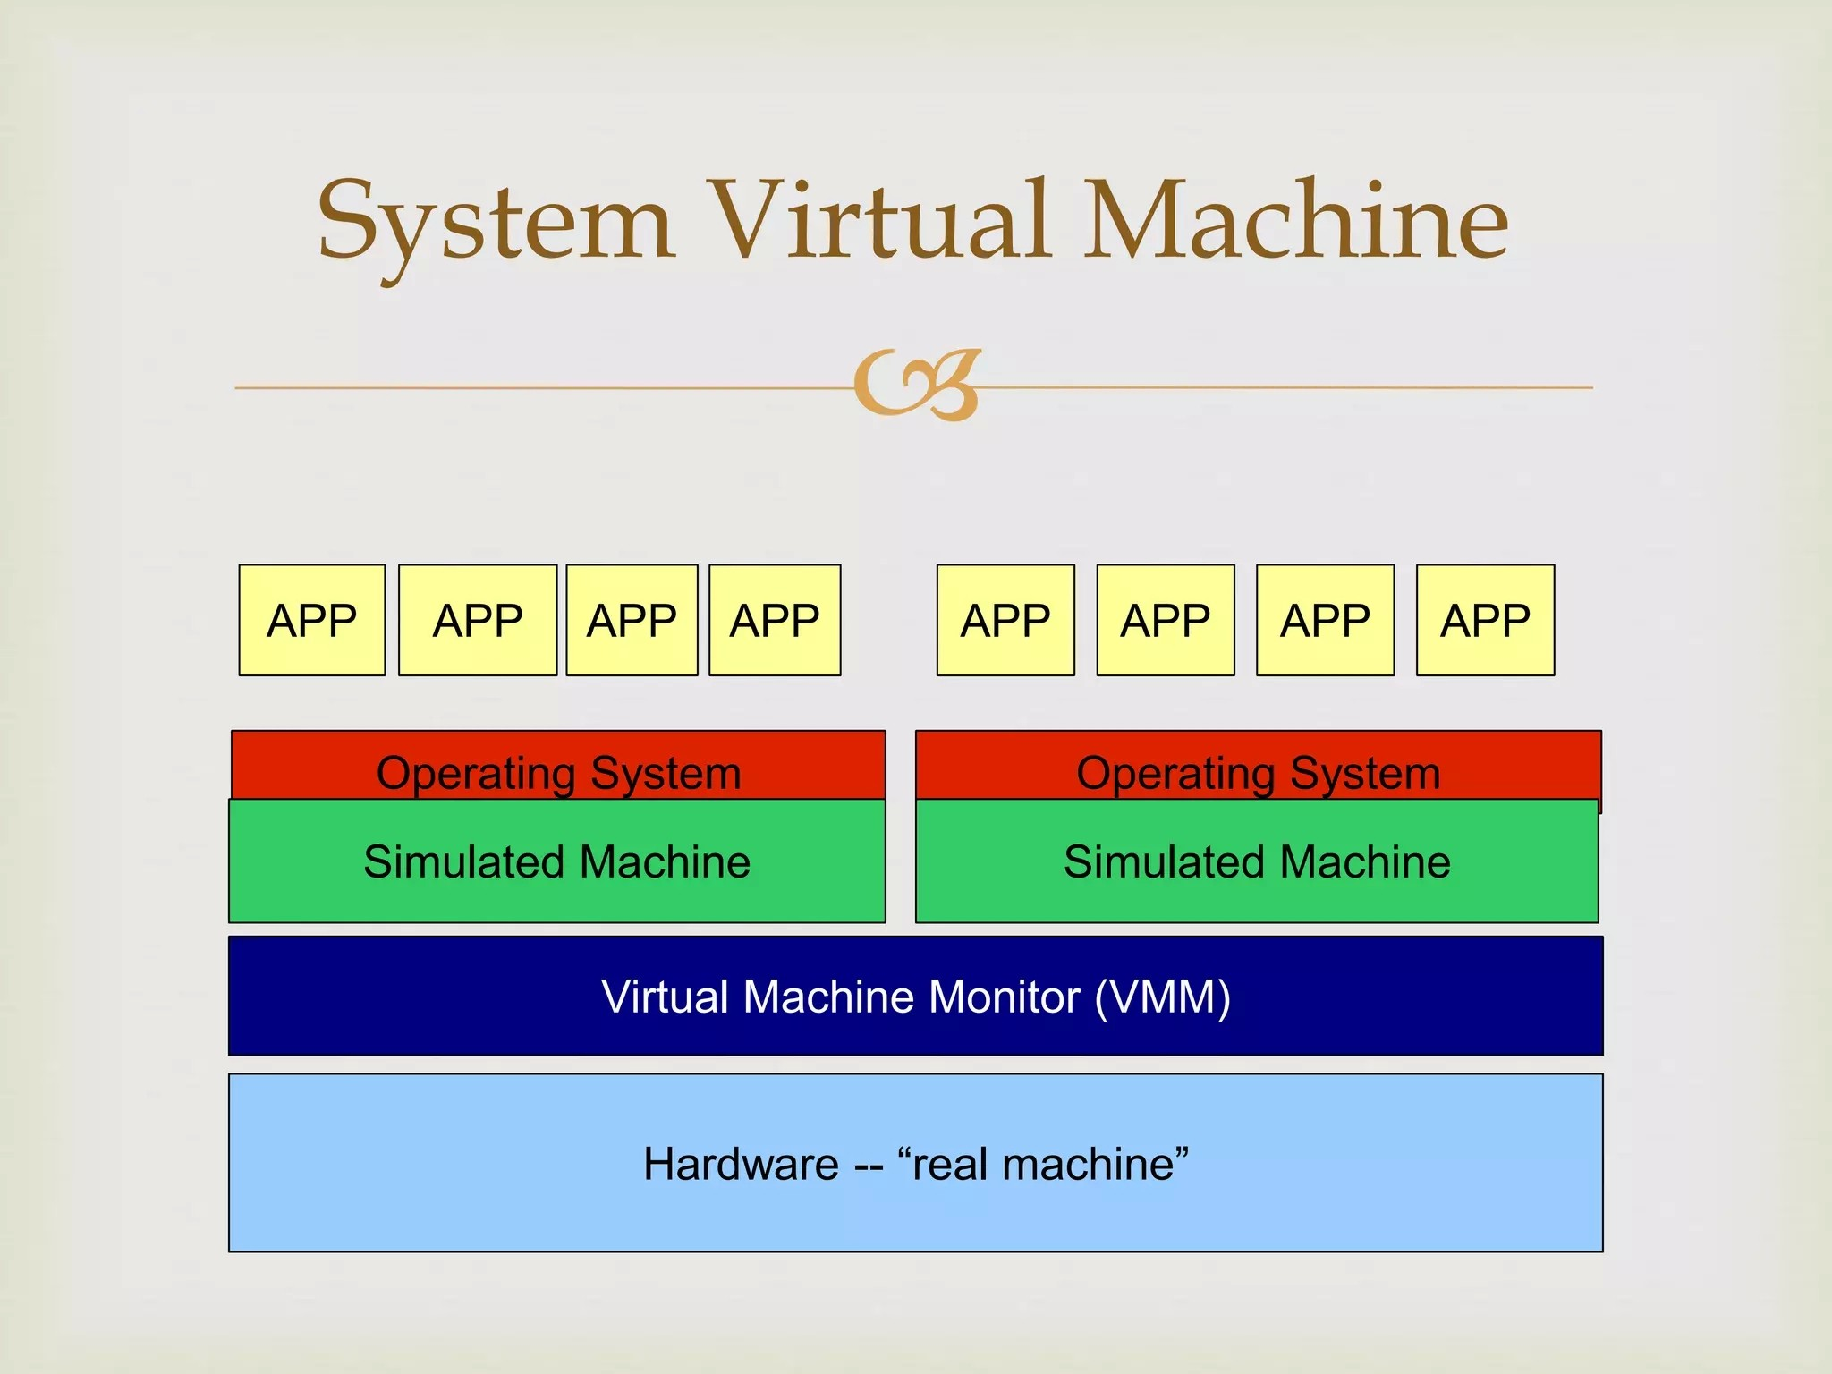

Slide 15



A process virtual machine allows a single process to run as an application on a host machine, providing a platform-independent programming environment by masking the information of the underlying hardware or operating system. An example of a process VM is the Java Virtual Machine, which enables any operating system to run Java applications as if they were native to that system.

Slide 16
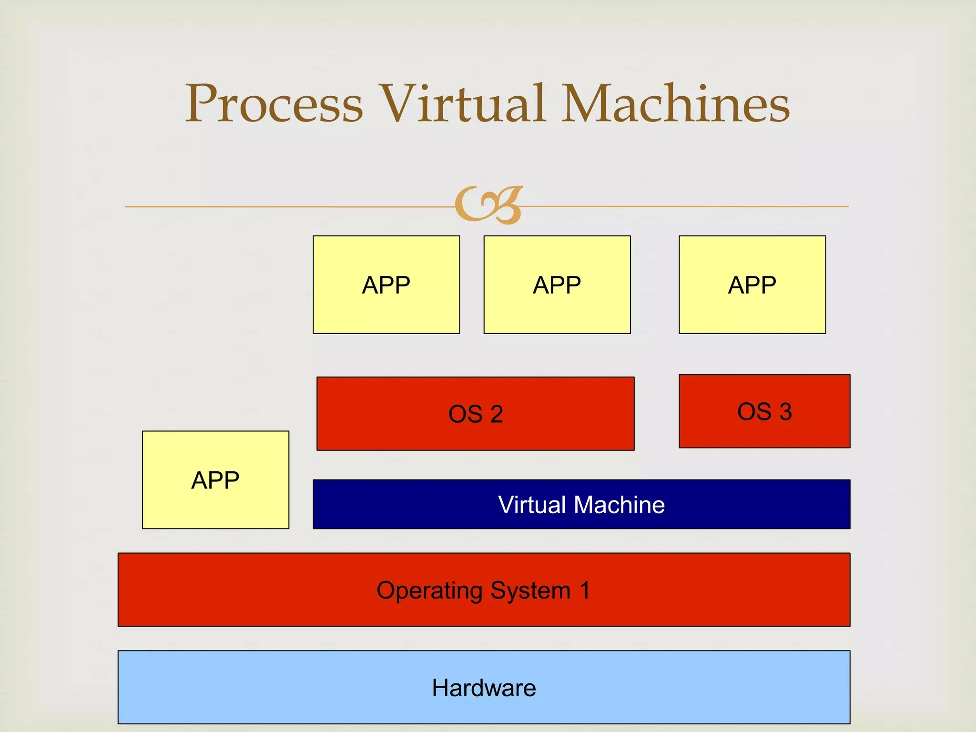

Slide 17

Virtual machines are a number of discrete identical execution environments on a single computer, each of which runs an operating system. This can allow applications written for one OS to be executed on a machine which runs a different OS which provide a greater level of isolation between processes than is achieved when rur+ning mulliple processes on the same instance of an OS.

